Slide 1
Updates 30 Nov 2021

Slide 2
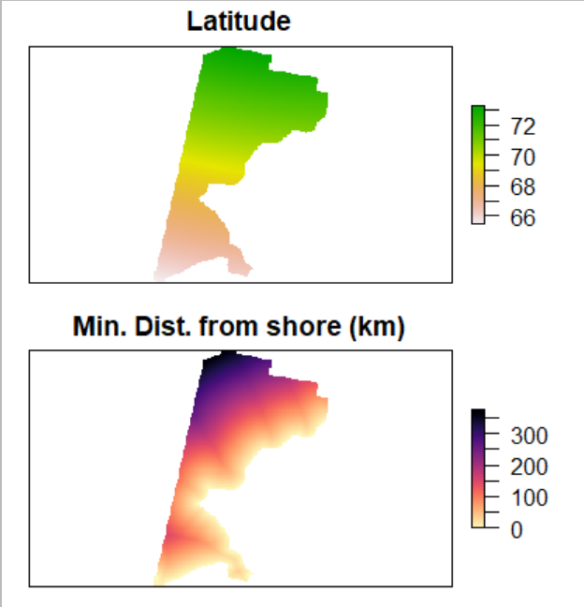
Chukchi STRS Optimization Prelim
Otter Trawl VAST model conditioned on 1990 and 2012
Two stratum variables based on Latitude and Distance from shore
Major axes of variation of density from VAST density maps
Five strata assumed

Slide 3
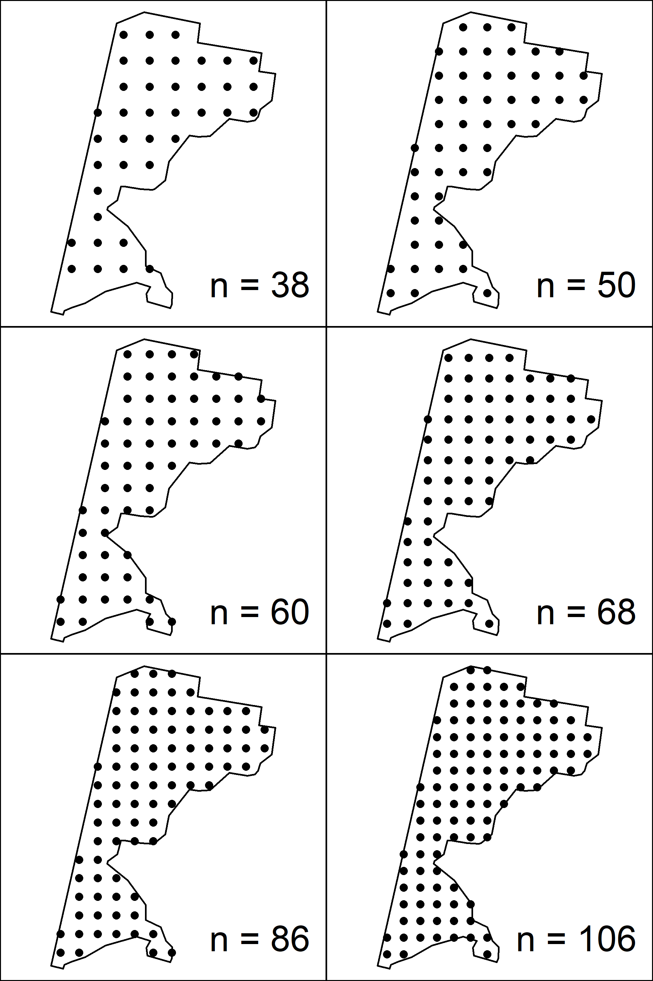
Chukchi STRS Optimization Prelim
Surveys were simulated under three designs
Simple Random
Systematic
Multispecies STRS from optimization
500 replicates, sample sizes ranging from 40 to 100
True CV, RRMSE of CV, sample CVs were compared

Slide 4
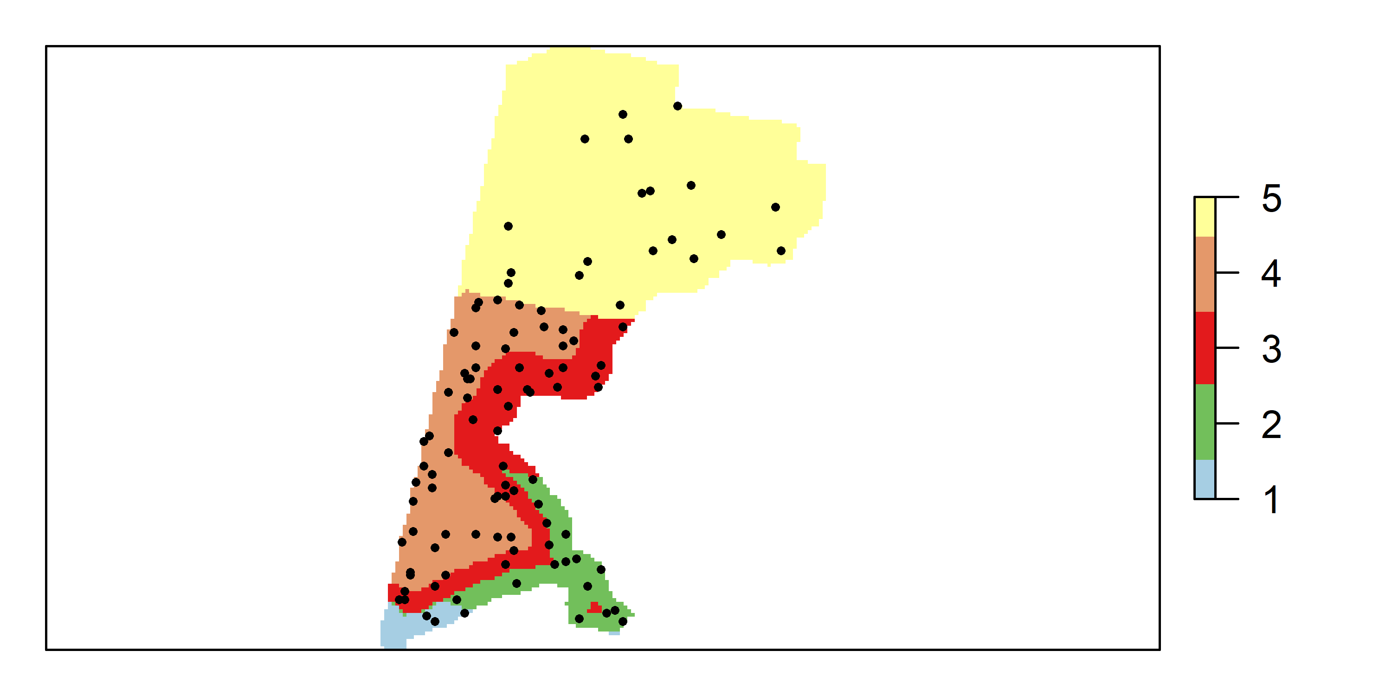
Otter Trawl MS STRS Solution (n = 100)
1 N/NE stratum, low sampling density
1 outer SW stratum
2-3 nearshore SW strata
Higher sampling in SW than NE

Slide 5
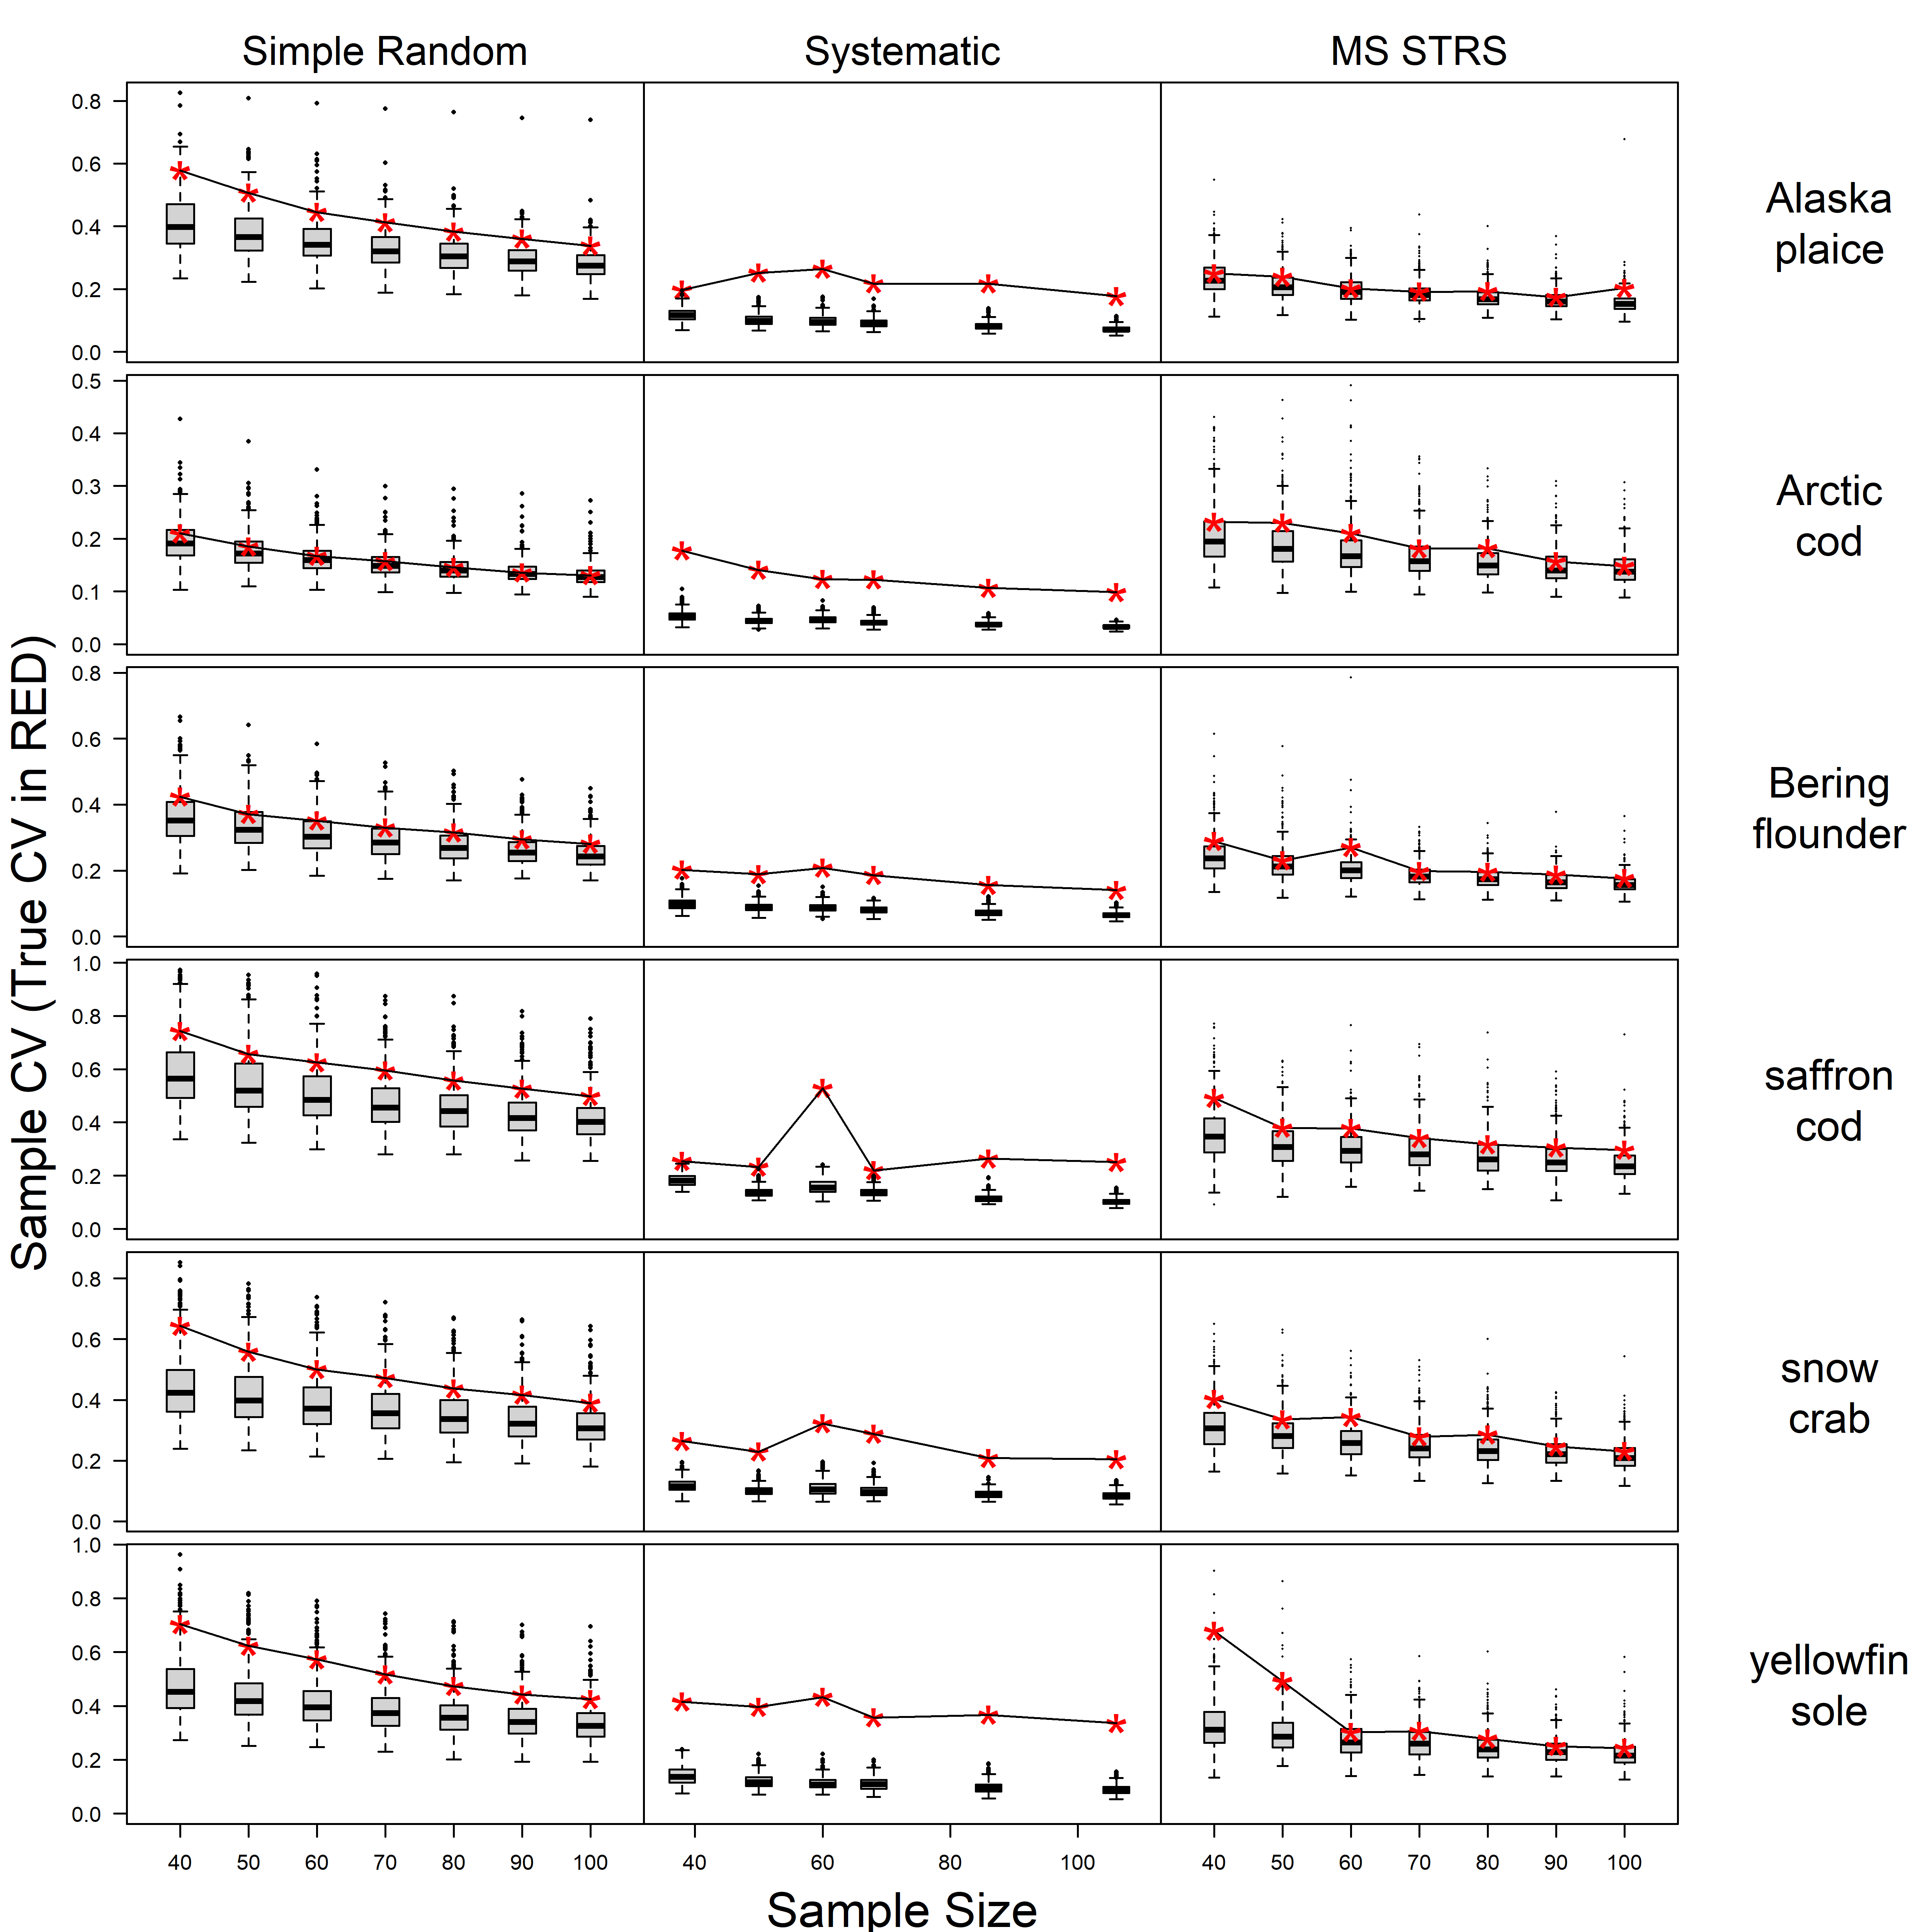
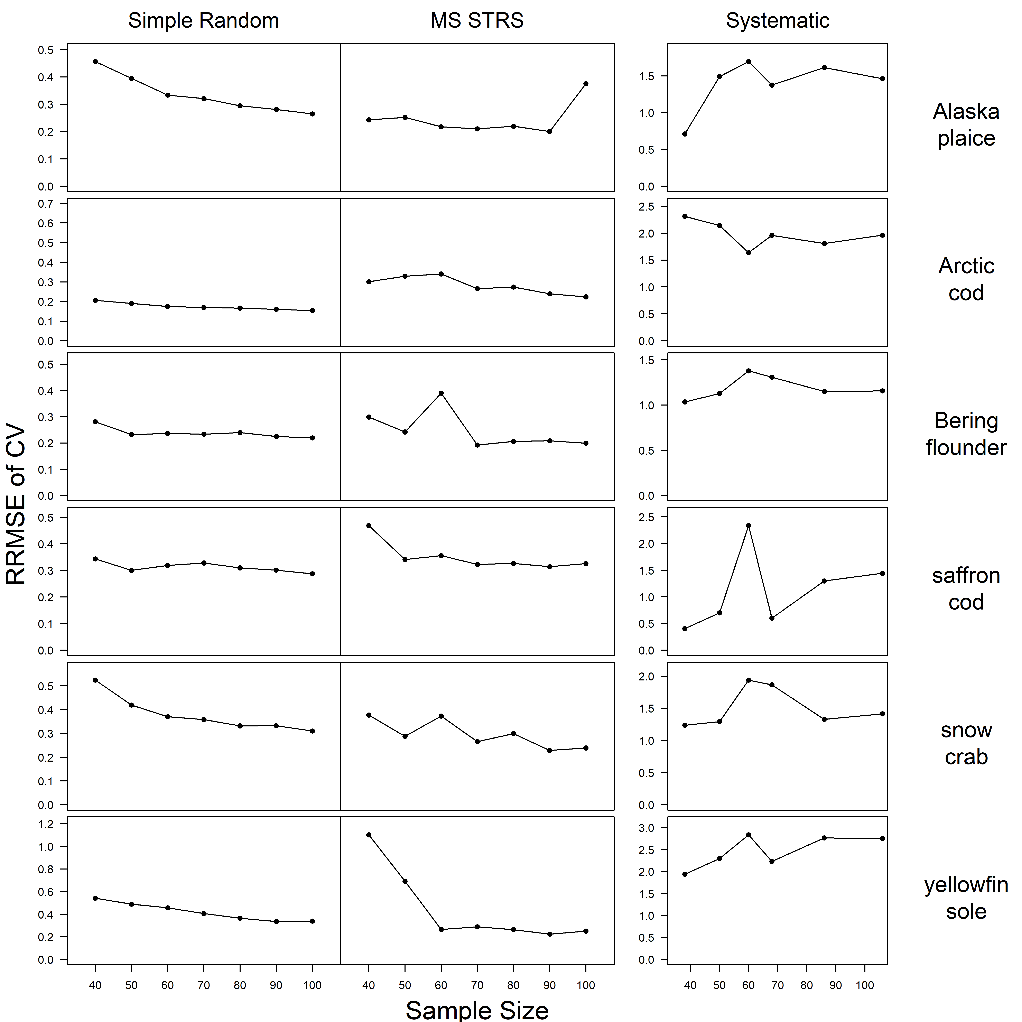
Sample CVs (w/TRUE CV) RRMSE of CV

Slide 6
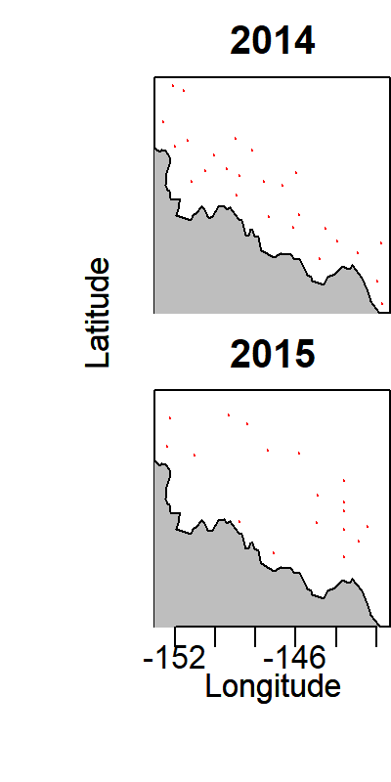
Beaufort VAST Runs
2014-2015 ANIMIDA Beam Trawl Data
Spatial Field in the positive response
Index CVs: 0.21, 0.24
Grid same 2 nm grid resolution as Chukchi

Slide 7
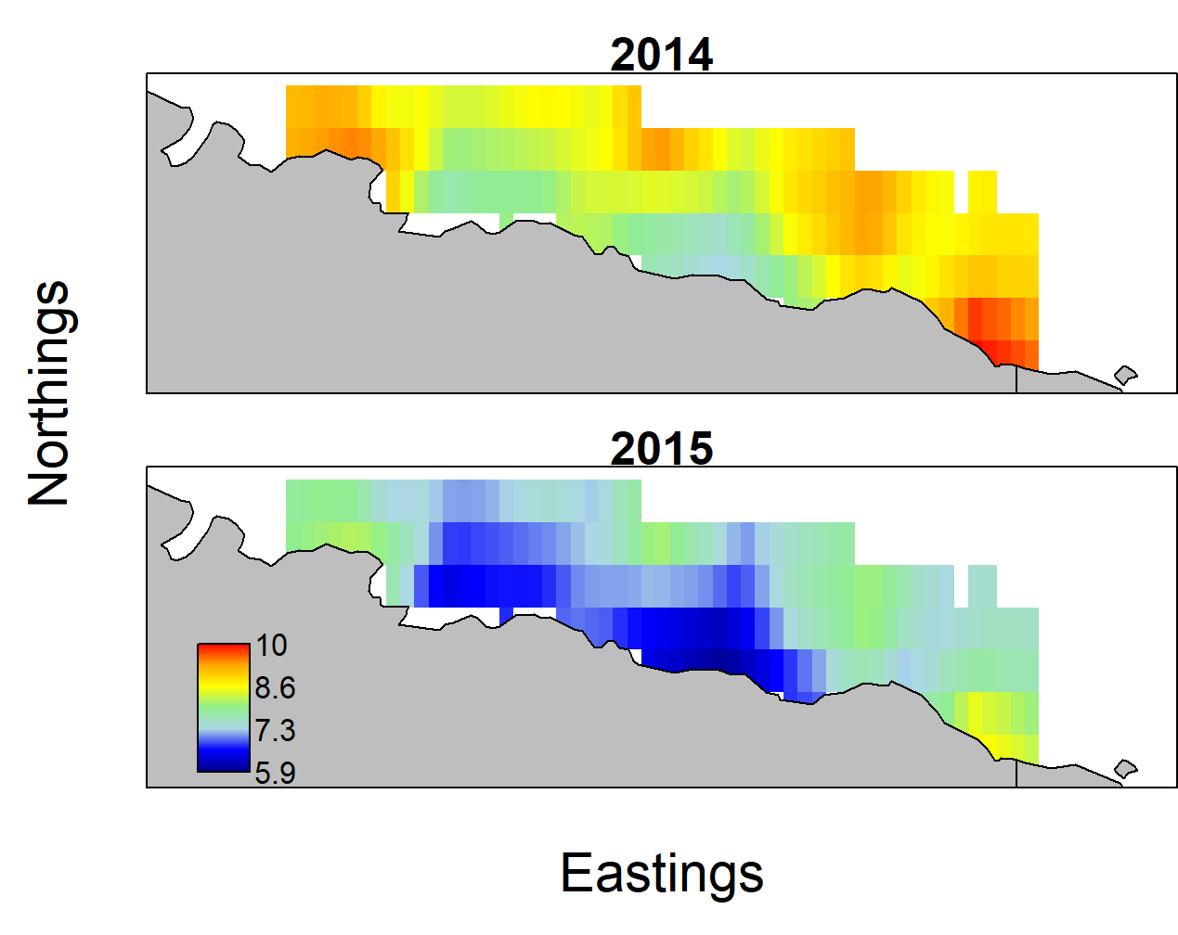
Beaufort VAST Runs
2014-2015 ANIMIDA Beam Trawl Data
Spatial Field in the positive response
Index CVs: 0.21, 0.24

